Slide 1



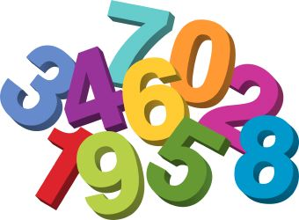

Someone Just Like You
by David Roberts
In Maths we will be …
Understanding place value
Counting forwards and backwards
Reading and writing numerals and numbers to 200 and beyond using the correct formation.
Addition & Subtraction
Using a variety of manipulatives
2D & 3D shapes
In English we will be …
Exploring a range of genres.
Reading stories with familiar settings and repeated language to support our narrative writing.
Understanding what makes a good sentence.
Writing captions, labels and signs and leaving notes
Exploring poetry and writing our own list poems.
Emerald
Curriculum Information
Autumn Term 2026
All About Me!
In PE we will be …
Taking part in parkour sessions, exploring moving our bodies in different ways.
Developing our basic skills when throwing and catching and when controlling the boy with our feet.
In Geography we will be …
Locating where the UK is on a world map
Talking about and observing different, typical weather in the UK
Learning about the different seas and oceans that surround the UK and the coastal features, including the different human and physical features.
In Art we will be …
Exploring line, shape and shading, drawing our own Paul Klee style self portrait drawings.
Understanding how to use tonal shading to create texture in observational drawing.
In PSHE we will be thinking about …
How we connect with others
What makes a goof friend
How we can help ourselves and others feel happy and safe.
In Science we will be …
Naming parts of a flowering plant.
Identifying and naming different plants around our school grounds
Observing the differences between deciduous and evergreen trees.
Our values for this term are:
Going for Gold value: Cooperation
Christian value: Generosity
In Computing we will be ...
Practising how to login and practising our ‘click and drag’ technique.
We will be developing our mouse skills and create a story board and self-portrait using digital tools.
Reminders…
Make sure you read at home every night and sign reading records.
PE takes place on a Monday and Thursday.
In RE we will be ...
Learning about a range of world views about God’s creation, including the view of Muslim, Jewish, Hindu and Christian people.

