Slide 1

Welcome to Emerald
Year 1 & 2

Slide 2
Teaching staff
Miss Wing – Emerald Class Teacher (Monday- Friday)
Miss Toye – Teaching Assistant (Monday – Friday)
Mrs Yiakoumi– Emerald Class Teacher (Thursday)

Slide 3


Slide 4
KS1 Expectations
Year 1 Phonics Screening - Week beginning 8th June
Year 2 SATs – non-statutory – June as part of Teacher Assessment

Slide 5

Useful websites
https://www.littlewandlelettersandsounds.org.uk/resources/for-parents/
https://www.phonicsplay.co.uk/resources
https://www.topmarks.co.uk/english-games/5-7-years/letters-and-sounds
https://home.oxfordowl.co.uk/reading/learn-to-read-phonics/

Slide 6



Reading
New Little Wandle Reading book (decodable book) will be sent home on a Wednesday and returned the following Monday.
This is a decodable book linked to their phonics ability.
- Library books – reading for pleasure book.
- Please ensure all books are returned on Monday.

Slide 7

Maths
Useful websites
https://play.ttrockstars.com/auth logins
https://www.topmarks.co.uk/maths-games/5-7-years/counting
https://www.ictgames.co.uk
https://whiterosemaths.com/homelearning/
https://whiterosemaths.com/resources/1-minute-maths#download

Slide 8

P.E.
Monday and Thursday
This half term we will be doing Parkour (indoor) and Basic Ball Skills (outdoor with coach Jason).

Slide 9
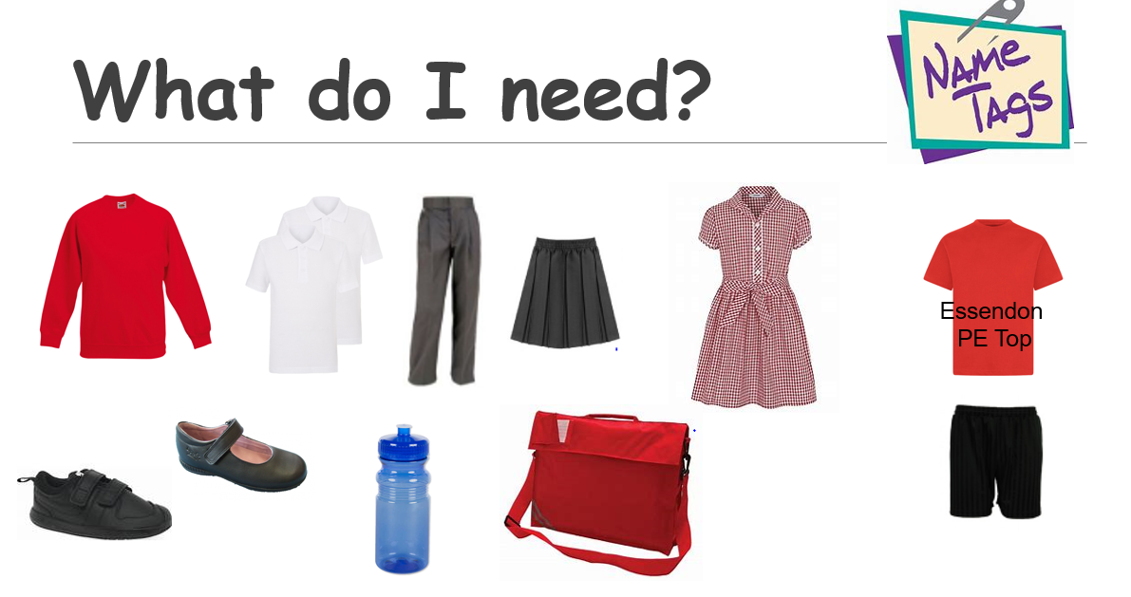
P.E.
Monday and Thursday
This half term we will be doing Parkour and Basic Ball Skills.

Slide 10
Office email:
Admin@essendon.herts.sch.uk

