Slide 1

Diamond Parent Information
Welcome to Year 5 and 6!
2026-2027
Mr C Brennan/E Green

Slide 2
Staff in Diamond Class
Class Teacher: Mr Brennan and Mrs Green
HLTA: Mrs Boswell-Fabulous and caring –more than capable of taking the class on her own at anytime

Slide 3
Mr Brennan’s Style
Very very firm ! 30 years a Teacher
Very very fair ! Not one drive by insulting as yet
Lots of humour/music/singing/drama but all business when needed
Active learning whenever possible-keep em moving-Active kids are happy kids-possible Teach Active being introduced?????????
Agile teaching whenever possible-Let them fly –Lessons can change course

Slide 4
Mrs Green’s Style
Although I am quiet, soft and kind by nature, I have very high expectations.
I encourage children to produce their best piece of work in every lesson and place great importance on handwriting, presentation and the children taking pride in their work.
I love teaching maths and believe that knowing your times tables is one of the most important things you can learn in life.
I am enjoying getting to know the children and finding out about their interests and lives outside of school.
Double the teachers = double the learning, double the laughs, double the fun!

Slide 5
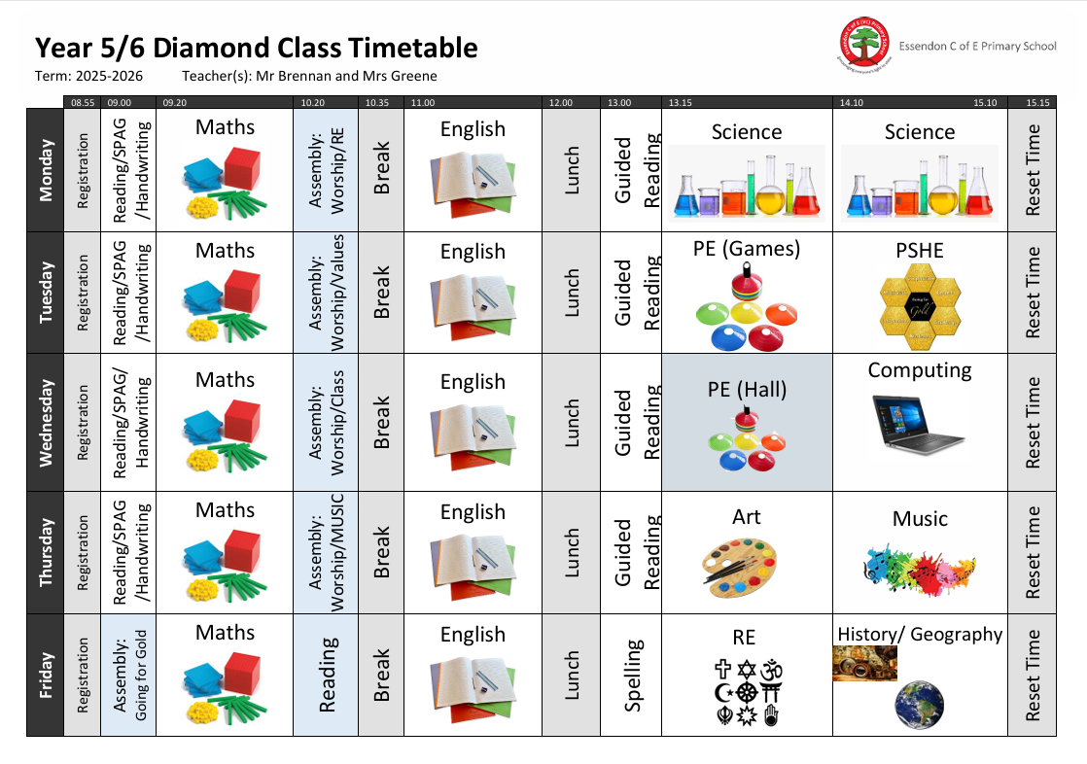

Slide 6
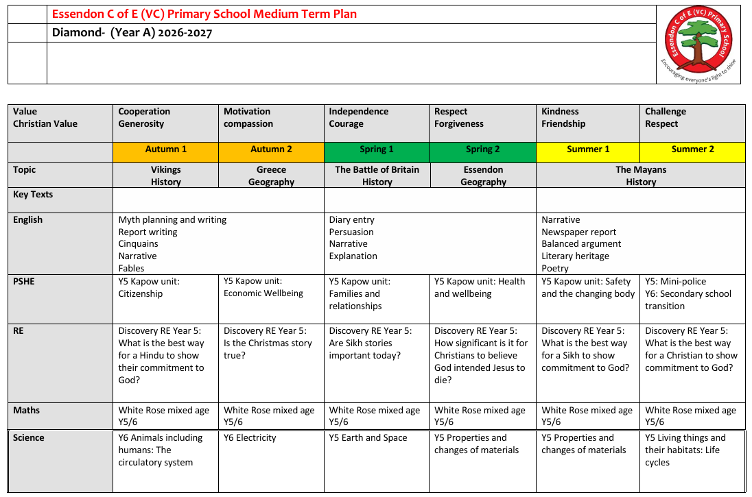

Slide 7
Home Learning
Timetables ongoing through TTRS for the rest of their lives
Spellings-New spelling programme just bought in from HFL.
CGP books (Year 6 only) Basic revision
Reading-everyday for the rest of their lives with a check every other morning and comments put in Reading Records. Please communicate with us through this whenever you need to.

Slide 8
Year 5/6 Special Notice
Lots of work to do to get them up to where they need to be to start secondary/Year 6 on a good footing
Reading/Tables every other night
Involvement in their education-What did you learn today ? Keep me on my toes !!!!!!
Enthusiasm and motivate them to enjoy school and learning
Let me know of any issues no matter how small

Slide 9
Walking home independently:Y6 only
Please provide Miss Moore at the school office with written permission for your child to walk home independently.
Contact Information
admin@essendon.herts.sch.uk

