Slide 1

Ruby Parent Information
Welcome to EYFS 2026-2025
Mrs Pryke, Miss Holding

Slide 2
Foundation Stage at Essendon CofE School
Throughout their time in EYFS, our aim is for children to partake in an ambitious curriculum which is designed to support their progress in reaching their Early Learning Goals (ELGs).
Our curriculum incorporates learning through play, learning by adults modelling, by observing each other and through guided learning and direct teaching. It is also important to highlight that our plans are flexible to allow us to respond quickly to children’s new interests and/or needs.

Slide 3



Early Years Foundation Stage Curriculum
Prime areas
  Communication and language
  Physical development
  Personal, social & emotional development
Specific areas.
  Literacy
  Mathematics
  Understanding the world
  Expressive arts and design

Slide 4
EYFS Characteristics of Effective Learning
Playing and exploring – playing with what I know, willing to have a go, finding out and exploring
Active learning –being involved and concentrating, keeping on trying, achieving what I set out to do
Creating and thinking critically – having my own ideas, making links, choosing ways to do things

Slide 5
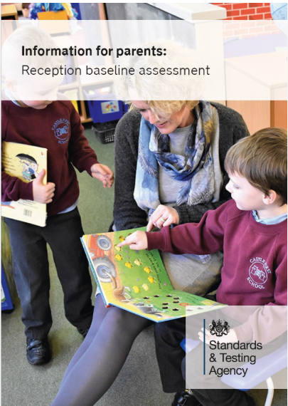

Reception Baseline Assessment
The Baseline Assessment is carried out during the first 6 weeks from starting school.
The RBA is an age-appropriate assessment, made up of 2 components assessing:
early mathematics
early literacy, communication and language
https://www.gov.uk/government/collections/reception-baseline-assessment

Slide 6
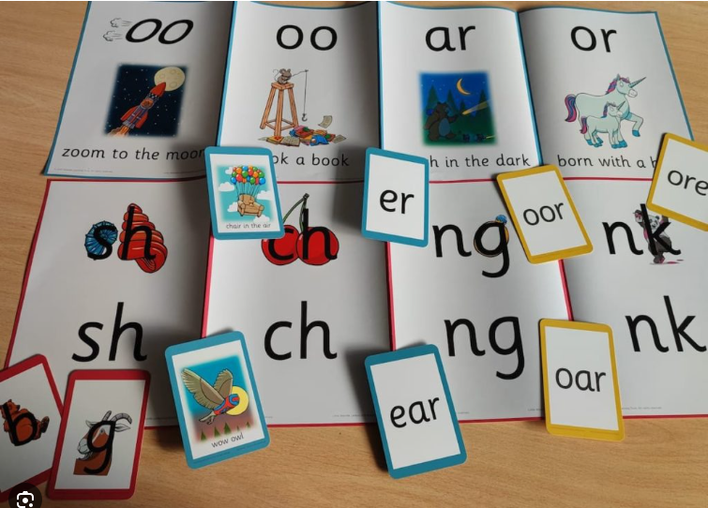
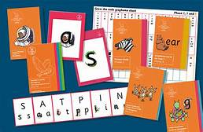
Little Wandle Phonics and Reading

Slide 7

Reception phonics
In Reception, children are taught phases 2, 3, and 4.
During phase 2, children learn what letters look like (grapheme) and the sounds (phonemes) they make.
In phase 3, children learn more complex sounds such as ‘ch’ and ‘air’ and how to read them in words. We call these digraphs (2 letters making 1 sound) and trigraphs (3 letters making 1 sound)
We learn how to write the sounds and words.
We learn how to blend sounds together for reading and segment sounds for writing.

Slide 8
Nursery phonics
In Nursery, children are taught the single graphemes in phases 2.
During phase 2, children learn what letters look like (grapheme) and the sounds (phonemes) they make.
Children are encouraged to learn using picture clues, objects, songs, rhymes.
We start the term learning the letters in the following order,
s, a, t, p, i, n

Slide 9
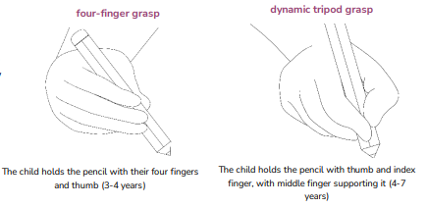
Early writing
The children also use their phonics skills to support their early writing.
In order to spell unknown words, children are taught to segment words into individual sounds.
We encourage children to write freely and use the sounds that they know. This means that their early writing is spelled phonetically and sometimes need a little bit of translation.
We encourage children to talk about their writing and share it with pride.
As the children memorise tricky words they also practise writing them.

Slide 10
Early writing
Later in the year, when the children learn to write sentences, we teach them 3 important things to try and include:
A capital letter at the beginning.
Finger spaces between the words .
A full stop at the end.
We teach the standard pencil grip and we would encourage you to support your child to use this at all times.

Slide 11
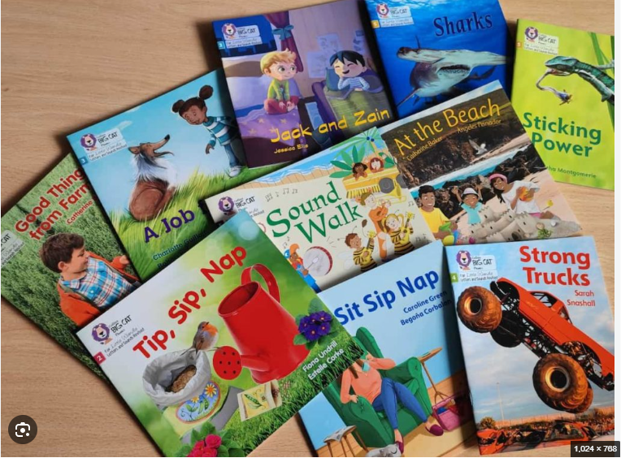
Reading
Your children will be given a weekly reading phonics book. You will have a reading book, reading record and reading folder.
Reading folders need to be in school every day .
Please persevere at home and read daily (or as often as you can) with your child even if it is just a few pages. Don’t worry if you don’t read the whole book every night; little and often is better than a long read once a week. Please record in your child’s reading record when you have read. This helps us when we talk with your child about the book as we can pick up on what has already been read.
From time to time children will come across words in their books that we call “tricky words” such as ‘said’ and ‘come.’ These are words which we are unable to decode using phonics and we just need lots of practice to recognise them on sight.

Slide 12

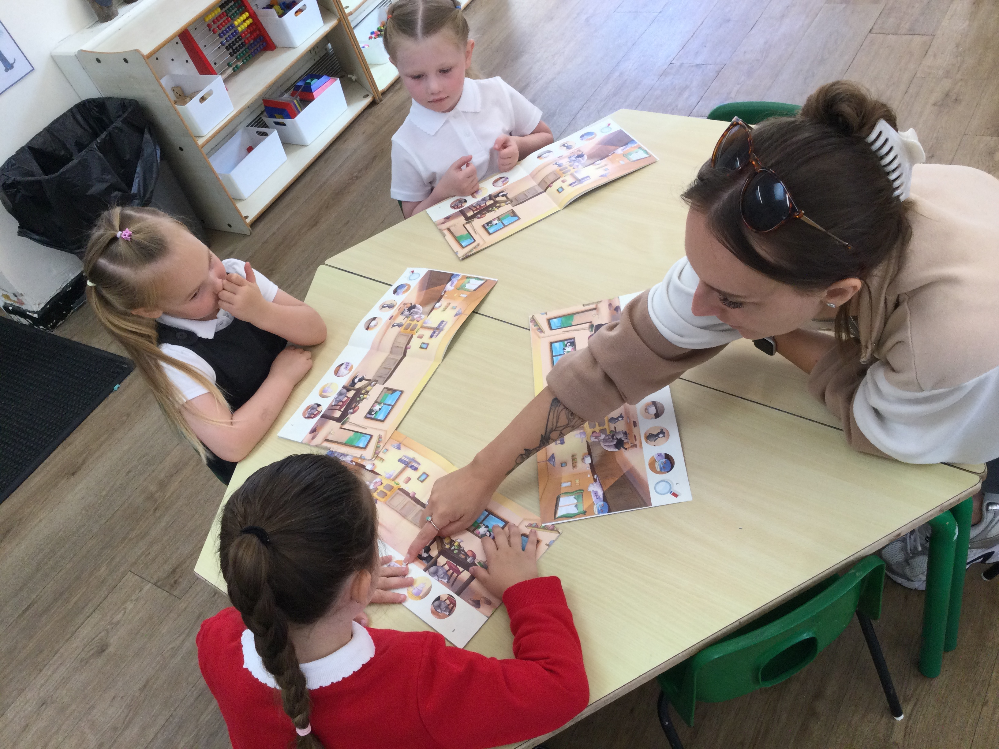
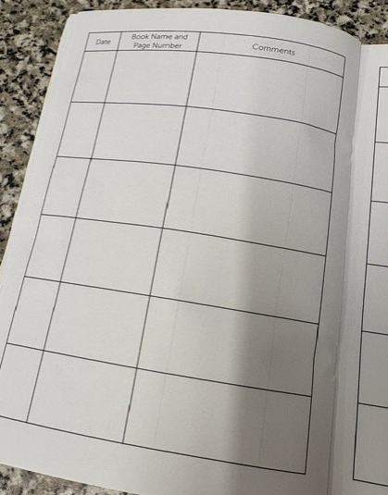

Slide 13
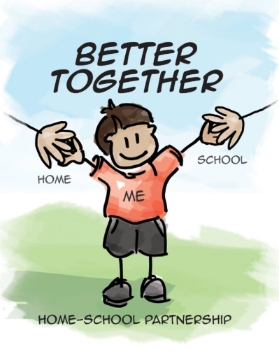

Parents as Partners
‘Parents and carers and other key adults make a crucial difference to children’s happiness, health and educational outcomes.’

Slide 14

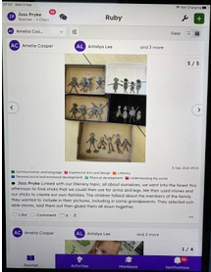

We love sharing your child’s leaning experiences through the platform Seesaw.

Slide 15
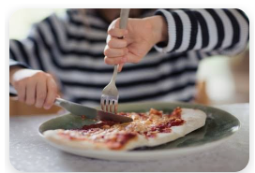
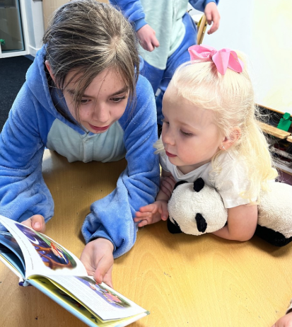

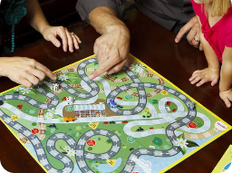
How can you help?
-read with your child
-encourage independence
-talking about their day
-play board games
-sing nursery rhymes
(https://www.bbc.co.uk/teach/school-radio/articles/zhwdgwx)

Slide 16




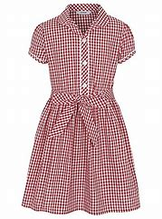


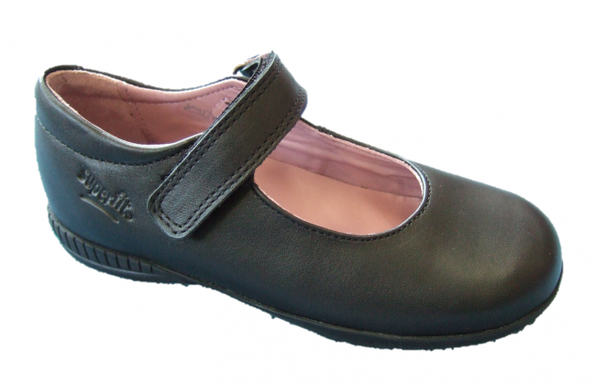




What do I need?
Essendon
PE Top
Not forgetting a warm, waterproof coat.

Slide 17



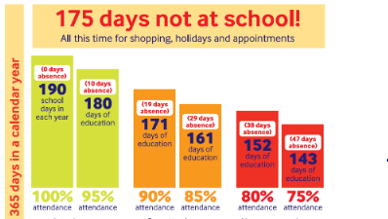


Attendance
Admin@essendon.herts.sch.uk

Slide 18




Any Questions

