Slide 1
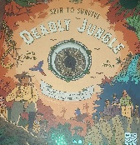

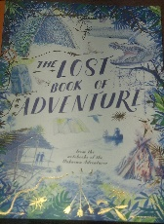
Key Texts:
1. Deadly Jungle by Emily Hawkins
2. The lost Adventure from the notebooks of the unknown adventurer.
Diamond
Curriculum Information
Summer 1– 2026
In Music we will be …
Dancing in the street
Reflect, Rewind, Replay
Playing set pieces on tuned instruments
In English we will be …
Narrative
Newspaper report
Biography
Poetry
Diary entry
In Maths we will be …
Shape
Position and direction
Solving problems
Short and long division, long division
Reasoning from known facts
In RE we will be ...
Does belief in Akhirah help Muslims lead better lives
In Science we will be …
Studying patterns in humans and other species, the children learn about inherited and environmental characteristics, understand how observations led Darwin and Wallace to develop theories, model finch variation and natural selection to explain species evolution and explore fossil evidence. (7 sessions) supporting this theory.
Animals: Human timeline (3 sessions).
In PSHE we will be thinking about …
Economic wellbeing
Prioritising needs over wants
The risks and considerations associated with spending money online
How interests and skills align with future careers
In Geography we will be …
Exploring the importance of the Oceans
Independent Fieldwork
Our value this term is:
Love yourself
In French we will be …
My French House
Planning a French Holiday
In PE we will be …
Learning to play dodgeball
Improving skills in throwing, dodging, jumping and catching, selecting and applying tactics
Swimming at Furzefield Leisure Centre.
Home learning
A maths and grammar home learning task will be set weekly on Thursday and collected in on Monday.
The times tables for the week will be introduced on Monday and tested on Friday.
10 spellings (5 curriculum, 5 personal) will be set on Monday and tested on Friday.
In Computing we will be ...
Exploring text-based programming with Python, the children learn how accurate syntax and nested loops control program.
Learning how to navigate the internet in an informed, safe and respectful way.
In Design Technology we will be …
Sculpture and 3D structures
Evaluating our product

