Slide 1

Diamond Parent Information
Welcome to Year 5 and 6!
2025-2026
Mr C Brennan

Slide 2
Staff in Diamond Class
Class Teacher: Mr Brennan and Mrs Terrell
TA: Mrs K Kersey/Ms Johnson-Fabulous and caring
SEN Teaching Assistant: Mrs Richmond (interventions) 3 mornings a week -Lovely
Mr Sousa(Stanley) 5 mornings a week -Average

Slide 3
Mr Brennan’s Style
Very, very firm ! 30 years a Teacher
Very, very fair ! Not one drive by insulting as yet
Lots of humour/music/singing/drama but all business when needed
Active learning whenever possible-keep them moving-Active kids are happy kids-possible Teach Active being introduced?
Agile teaching whenever possible-Let them fly –Lessons can change course

Slide 4
Mrs Terrell’s Style
Always trying to be firm – but after three years most of the class know exactly which buttons to press!
9 years a teacher – still chasing Mr Brennan’s 30-year head start
Thought I was dramatic… until I met Mr Brennan: Suddenly I look calm!
Love a bit of drama, fun and laughter – but always aiming high
Hoping to learn and grow with my legendary job share partner
Double the teachers = double the learning, double the laughs, double the fun!

Slide 5
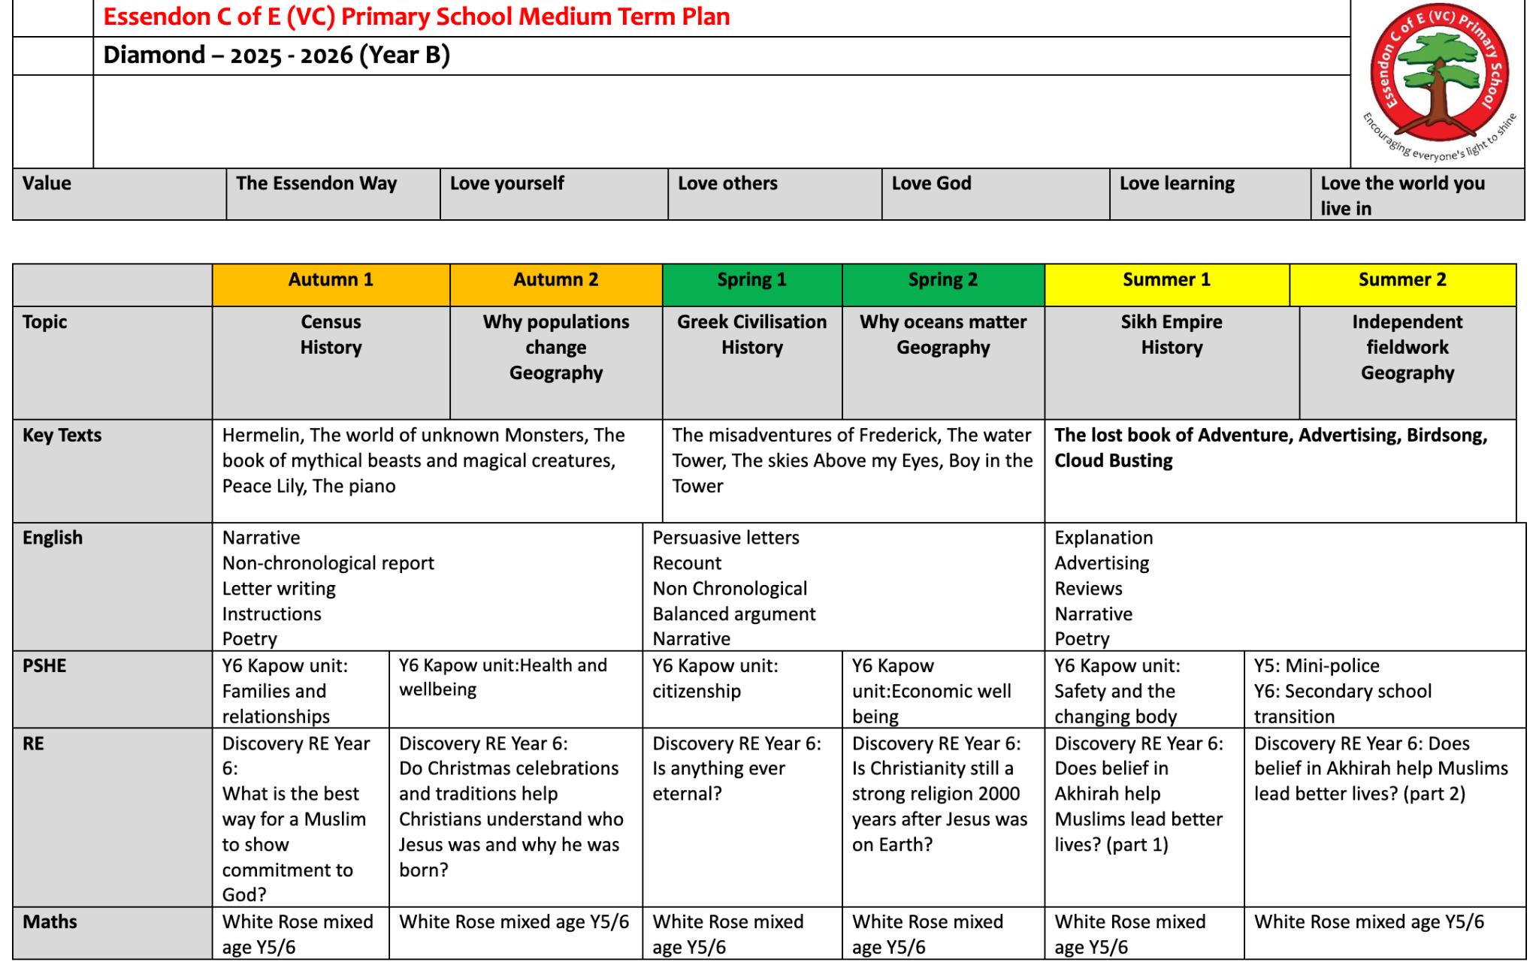

Slide 6
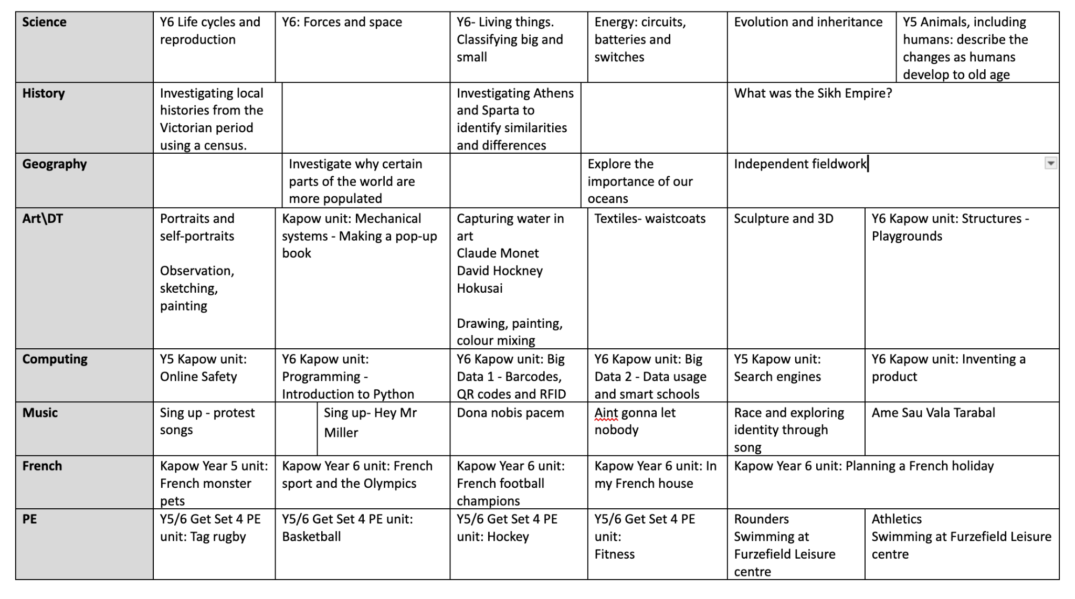

Slide 7
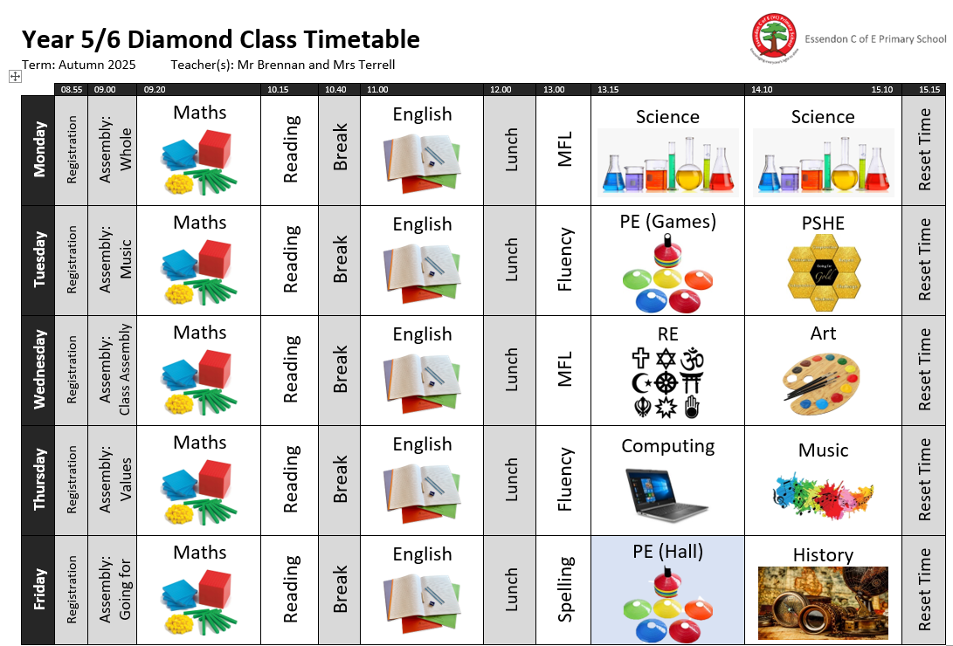

Slide 8
Home Learning
Timetables ongoing through TTRS for the rest of their lives
Spellings-32 given out at start of half term and ten chosen for a test on either Thursday or Friday
CGP books may be used as homework going forward for both Grammar and Maths as well as early morning work.
Reading-everyday for the rest of their lives with a check every Friday morning and comments put in Reading Records. Please communicate with us through this whenever you need to.

Slide 9
Year 6 Special Notice
Mock Sats last week are still being marked
Early results are not ideal-No one passing as yet
Lots of work to do to get them up to where they need to be to start secondary on a good footing
Reading/Tables every other night
Involvement in their education-What did you learn today ? Keep me on my toes !
Enthusiasm and motivate them to enjoy school and learning
Let me know of any issues no matter how small

Slide 10
Walking home independently:Y6 only
Please provide Miss Moore at the school office with written permission for your child to walk home independently.
Contact Information
admin@essendon.herts.sch.uk

