Slide 1
Curriculum
Meeting
Reception and Nursery

Slide 2

Welcome to our Learning Community!

Slide 3
Staff
Mrs O’Connor – Pantherswood Class Teacher
Mrs Bines – Early Years Teaching Assistant
Miss Hodgson – Early Years Teaching Assistant

Slide 4



Early Years Foundation Stage Curriculum
Prime areas
  Communication and language
  Physical development
  Personal, social & emotional development
Specific areas.
  Literacy
  Mathematics
  Understanding the world
  Expressive arts and design

Slide 5
EYFS Characteristics of Effective Learning
Playing and exploring – playing with what I know, willing to have a go, finding out and exploring
Active learning –being involved and concentrating, keeping on trying, achieving what I set out to do
Creating and thinking critically – having my own ideas, making links, choosing ways to do things

Slide 6
Foundation Stage at Essendon CofE School
Throughout their time in the Reception Year our children partake in an ambitious curriculum which is designed in a sequential way to ensure progress towards the end of reception goals. These goals are defined as Early Learning Goals (ELGs).
Our curriculum incorporates learning through play, learning by adults modelling, by observing each other and through guided learning and direct teaching. It is also important to highlight that our plans are flexible to allow us to respond quickly to children’s new interests and/or needs.

Slide 7


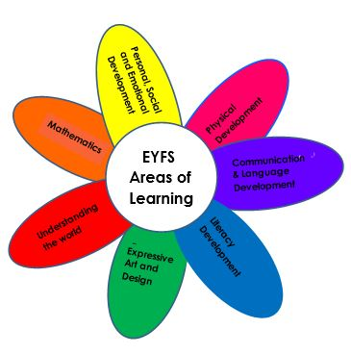



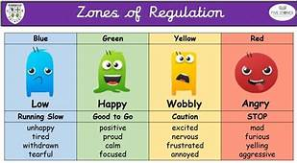
Foundation Stage at Essendon CofE School
Encouraging everyone’s light to shine

Slide 8
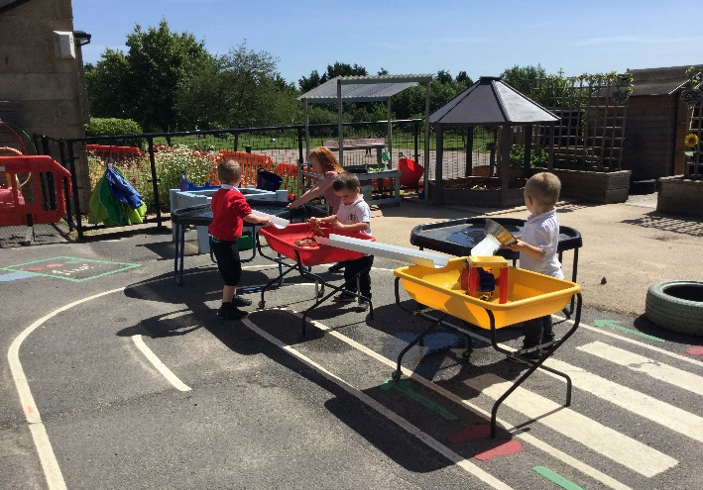
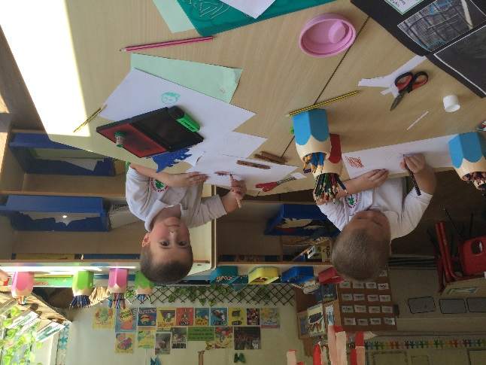
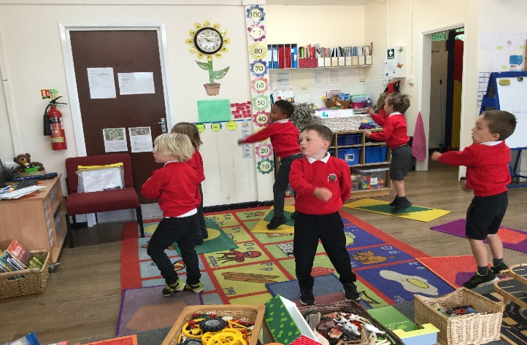
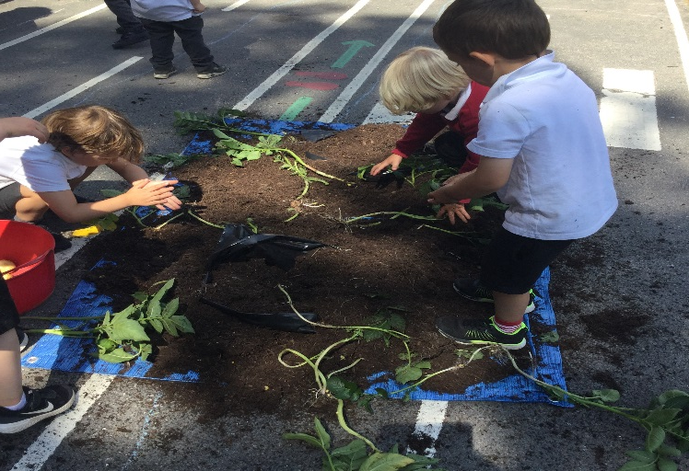
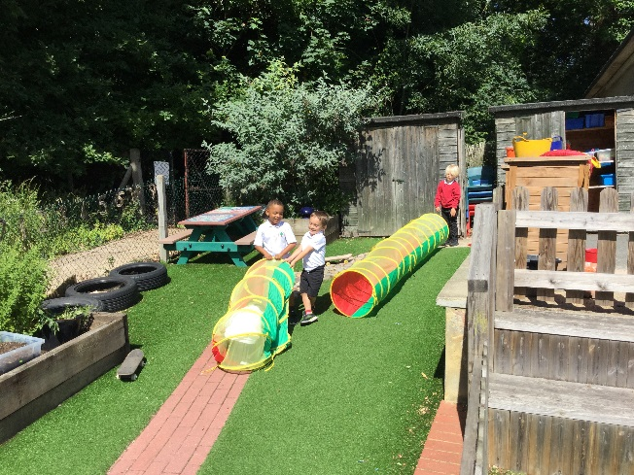
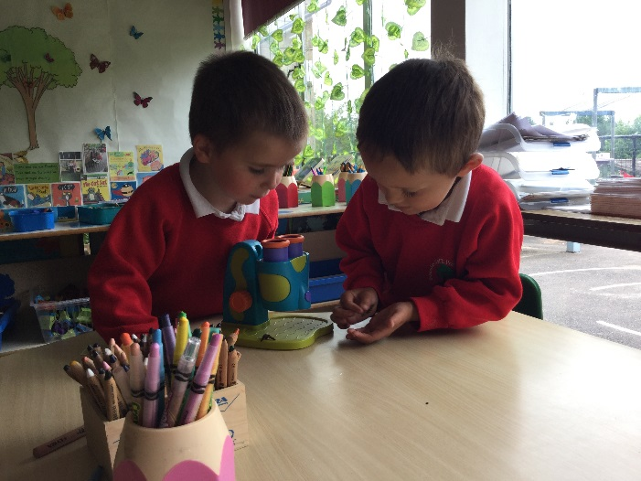
A Day in Reception and Nursery

Slide 9


Little Wandle Phonics and Reading

Slide 10

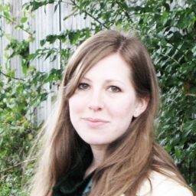
Hello Friend! tells the story of one big-hearted and enthusiastic little girl who is insistent on making friends with a certain little boy. And why wouldn't he want to be friends with her? She's very good at sharing – even if it's a sandwich that he doesn't like. And she's certain that playing outside is their favourite thing to do, even if he is not so sure. But while he doesn't seem keen on many of the things that she loves to do, there is one thing he's very keen on after all . . . being friends.
Rebecca Cobb is a British children's book illustrator. She grew up in Buckinghamshire and Somerset and now lives in Falmouth. Along with writing and illustrating her own books, she has also collaborated with other authors including Julia Donaldson, Richard Curtis and Helen Dunmore.

Slide 11







Reading Journal

Slide 12
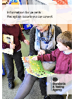


Reception Baseline Assessment
The Baseline Assessment is carried out during the first 6 weeks from starting school.

Slide 13


Parents as Partners
‘Parents are a major influence on a child’s success in life. While the quality of schools and the nature of the child’s peer group matter significantly, it is from the home that young people derive lasting effects on their character and mindset.’
-parent consultations
-sharing experiences
-sharing afternoons

Slide 14




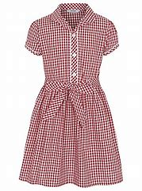


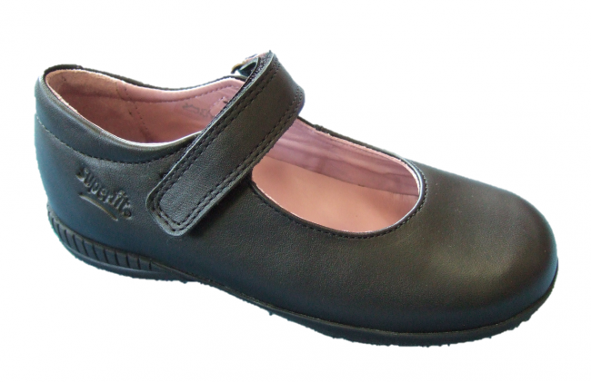

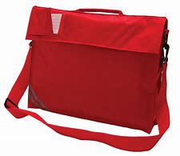

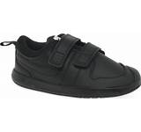
What do I need?
New Essendon PE Top

Slide 15

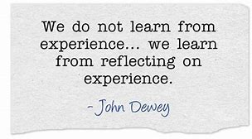



Share with us!

Slide 16



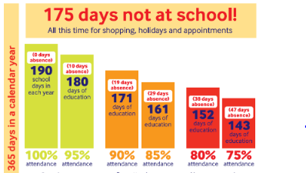


Attendance

Slide 17
Being Prepared
-sharing the transition activities with your child
-reading with your child
-completing getting to know you activities on Tapestry
-preparing them for independence
-talking about this next step!

Slide 18
Email
Admin@essendon.herts.sch.uk
pantherswood@essendon.herts.sch.uk

Slide 19

Starting Reception in September 2022
Friday 2nd September – Children will come in at 8.40 and leave at 11.45 am
Monday 5th & Tuesday 6th September - – Children will come in at 8.40 and leave at 11.45 am
Wednesday 7th to Friday 9th September -
Children will arrive at 8.40 am and leave at 1.15 pm having had lunch at school.
This can either be a home packed lunch, or a school dinner and menus will be included in your pack. All Reception children receive a free school dinner under the Government’s Universal Free School Meals scheme.
Monday 12th September onwards –
Children will start school at 8.40 am and leave at 3.15 pm.
First Few Days
.
Starting Nursery in September 2022
Friday 2nd September – Children will come in at 8.40 and leave at 11.45 am
Monday 5th & Tuesday 6th September – Children will come in at 8.40 and leave at 11.45 am
Wednesday 7th to Friday 9th September -
Nursery children (15 hours) – arrive at 8.40 am and leave at 11.45 am
Nursery children (30 hours) – arrive at 8.40 am and leave at 1.15 pm having had lunch at school.
This can either be a home packed lunch, or a school dinner and menus will be included in your pack. Unfortunately, Nursery parents have to pay for their children’s lunches at a cost of £2.65 per day and can be ordered in advance on ParentMail.
Monday 12th September onwards –
Nursery children (15 hours) will continue to arrive at 8.40 am and leave at 11.45 am.
Nursery children (30 hours) – the ‘normal’ school day is 8.40 to 3.15 pm.
This is more than 30 hours, but there are several different options available to you.

Slide 20




Any Questions

Slide 21
Summer Transition Open Afternoons

